Slide 1
Functions
A function is a block of code that is executed when it is called. You can pass data, known as parameters, into a function. A function can return data as a result
There are two types of function
Pre-defined Function
User-defined Function
math.ceil(4.5)
math.floor(7.8)
def Add():
function body

Slide 2
Pre-defined Functions
abs()
aiter()
all()
any()
anext()
ascii()
bin()
bool()
breakpoint()
bytearray()
bytes()
callable()
chr()
classmethod()
compile()
complex()
delattr()
dict()
dir()
divmod()
enumerate()
eval()
exec()
filter()
float()
format()
frozenset()
getattr()
globals()
hasattr()
hash()
help()
hex()
id()
input()
int()
isinstance()
issubclass()
iter()
len()
list()
locals()
map()
max()
memoryview()
min()
next()
object()
oct()
open()
ord()
pow()
print()
property()
range()
repr()
reversed()
round()
set()
setattr()
slice()
sorted()
staticmethod()
str()
sum()
super()
tuple()
type()
vars()
zip()
__import__()

Slide 3
Syntax for User Defined Functions
1.Keyword def marks the start of the Function
2.Unique Function Name
3.Optional Parameters
4.Colon (:) to the End of the Function Heading
5.Indentation Level
6.Optional Return Statement
def <function name> (<parameter>) :
statements
return statement

Slide 4
Function Definition & Function Call
Function Definition
Syntax:
def <function Name> (Parameters list):
Example
def Add() :
a = 10
b = 20
c =a+b
print(c)
Function Call
Syntax:
<function Name> (Parameters list)
Example
Add()

Slide 5
Function Arguments/Parameters
Syntax:
def <function Name> (Parameter_1, Parameter_2,…,Parameter_N):
Example
def Add(a,b) :
c =a+b
print(c)
x = 10
y = 20
Add(x,y)
Formal Parameters/arguments
Actual Parameters/arguments

Slide 6
Function Return type
Syntax:
def <function Name> (Parameter_1, Parameter_2,…,Parameter_N):
#calculation
return <argument>
Example
def Add(a,b) :
c =a+b
return c
x = 10
y = 20
z = Add(x,y)
print(z)

Slide 7
Function Defining Styles
Function with argument and with return type
Function without argument and without return type
Function with argument and without return type
Function without argument and with return type

Slide 8
Function with argument and with return type
Syntax
def <function name>(parameter_1, parameter_2,…):
#calculation
return <argument>
<variable name> = <function name>(arugments)
Example
def Add(a,b):
c = a + b
return c
x = 10
y = 20
z = Add(x,y)
print(z)

Slide 9
Function without argument and without return type
Syntax
def <function name>( ):
#calculation
<function name>( )
Example
def Add():
a = 10
b = 20
c = a + b
print(c)
Add( )

Slide 10
Function with argument and without return type
Syntax
def <function name>(parameter_1, parameter_2,…):
#function body
<function name>(arugments)
Example
def Add(a,b):
c = a + b
print(c)
x = 10
y = 20
Add(x,y)

Slide 11
Function without argument and with return type
Syntax
def <function name>( ):
#function body
return <argument>
<variable name> = <function name>( )
Example
def Add():
a = 10
b = 20
c = a + b
return c
z = Add()
print(z)

Slide 12
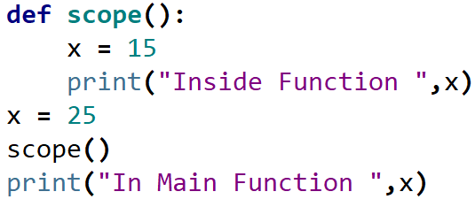

Scope & Lifetime

Slide 13
Recursion Function
Python also accepts function recursion, which means a defined function can call itself
Rules for recursion function
A recursive algorithm must call itself, recursively.
A recursive algorithm must have a base case.
A recursive algorithm must change its state and move toward the base case.

Slide 14
Recursion Function - Example
Factorial(5)
5
n = 5
return 5 * Factorial(4)
4
n = 4
return 4 * Factorial(3)
3
n = 3
return 3 * Factorial(2)
120
24
6
2
2
Example
def Factorial(n):
if n == 1:
return 1
else:
return n * Factorial(n-1)
z = Factorial(5)
print(z)
n = 2
return 2 * Factorial(1)
1
1
n = 1
return 1

Slide 15
Lambda Functions
A lambda function is a small anonymous function.
A lambda function can take any number of arguments, but can only have one expression.
Syntax:
lambda arguments : expression
Example:
statement = lambda : "Hello" square = lambda x : x**2 area = lambda x,y : x*y
print(statement()) print(square(4)) print(area(4,7))

Slide 16
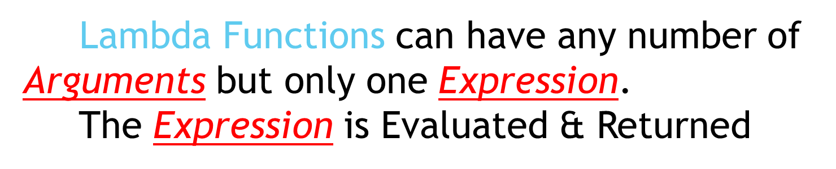
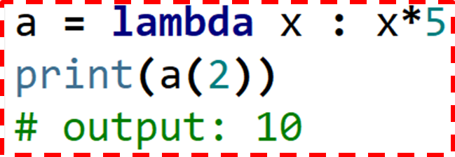
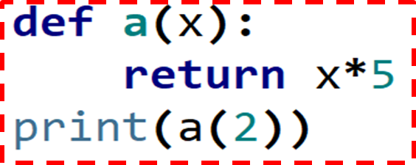
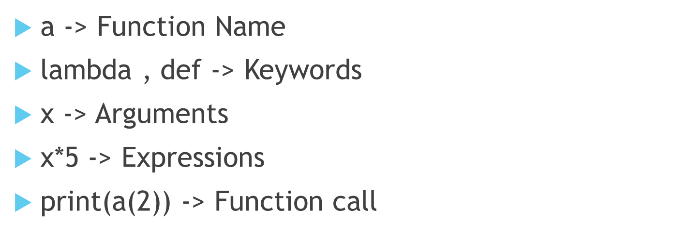

Slide 17
Modules
A module is a file containing Python definitions and statements.
Types of Modules
In-built modules
User-defined modules

Slide 18
In-built Modules
Text Processing Services
Numeric and Mathematical Modules
File and Directory Access
File Formats
Generic Operating System Services
Networking and Interprocess Communication
Internet Data Handling
Structured Markup Processing Tools
Graphical User Interfaces with Tk

Slide 19
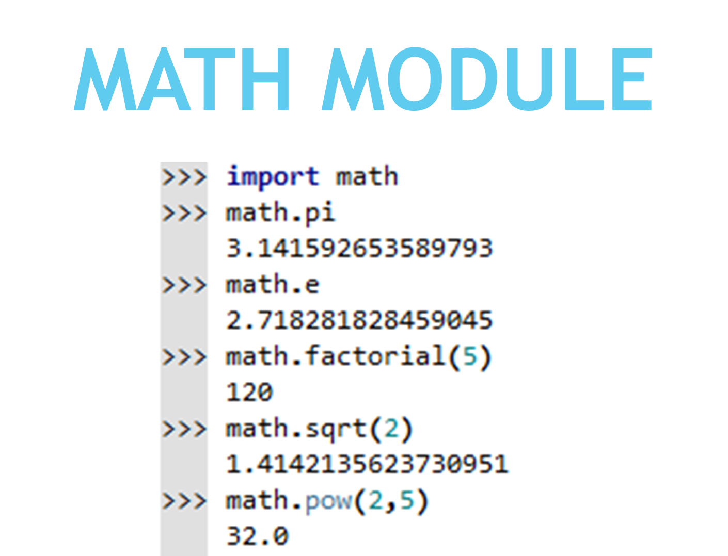

Slide 20
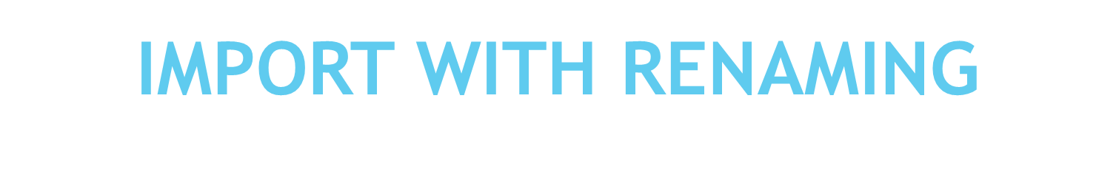
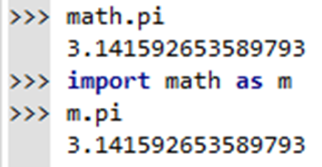
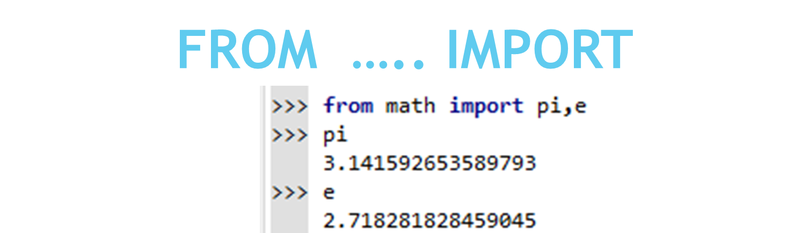
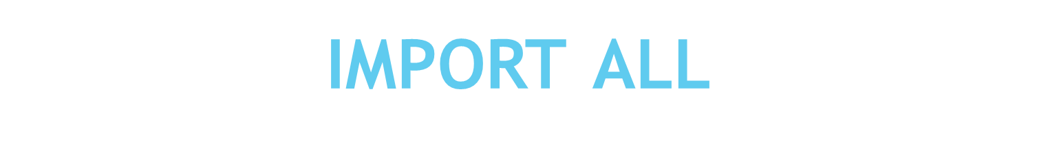
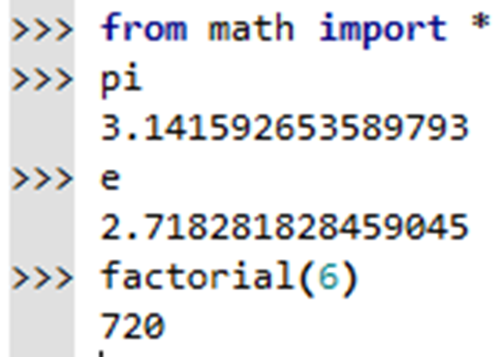

Slide 21
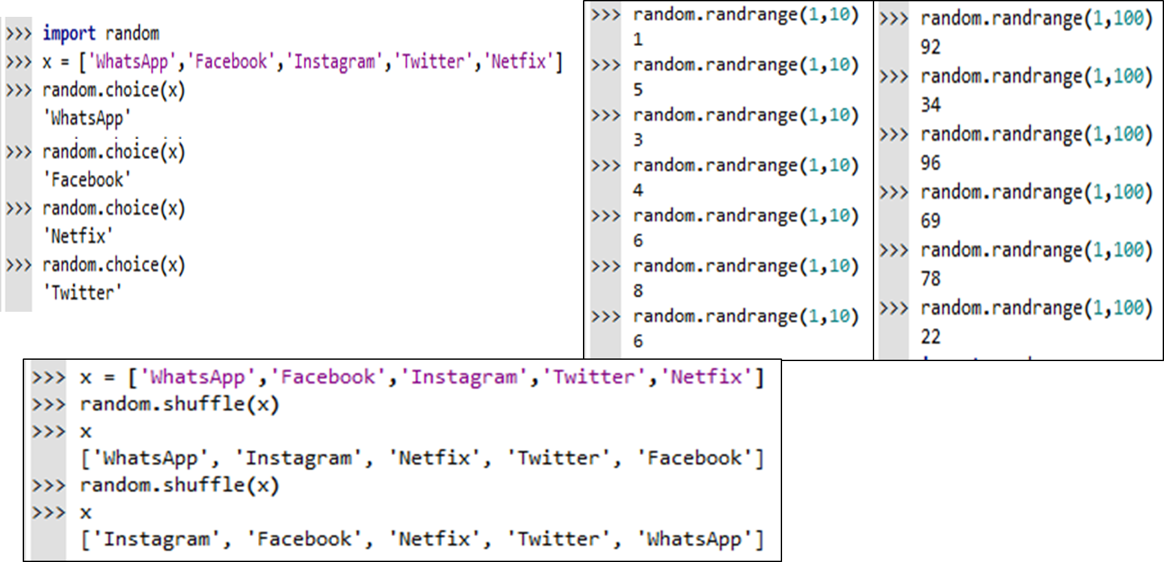
RANDOM MODULE

Slide 22
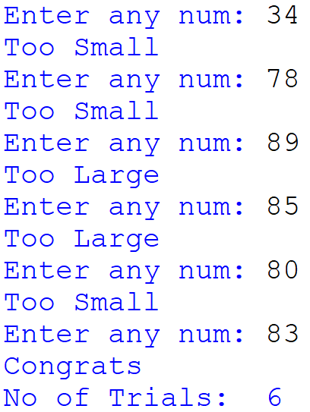
GUESS THE NUMBER GAME
from random import *
rn = randrange(1,100)
#print(rn)
count = 0
while True:
num = int(input("Enter any num: "))
count+=1
if num>rn:
print("Too Large")
elif num<rn:
print("Too Small")
elif num == rn:
print("Congrats")
Break
else:
print("Invalid")
print("No of Trials: ",count)

Slide 23
Date & Time
Python Datetime module supplies classes to work with date and time.
The DateTime module is categorized into 6 main classes –
date – the current Gregorian calendar always was, and always will be, in effect. Its attributes are year, month and day.
time – An idealized time, independent of any particular day, assuming that every day has exactly 24*60*60 seconds.
datetime – Its a combination of date and time along with the attributes year, month, day, hour, minute, second, microsecond, and tzinfo.
timedelta – A duration expressing the difference between two date, time, or datetime instances to microsecond resolution.
tzinfo – It provides time zone information objects.
timezone – A class that implements the tzinfo abstract base class as a fixed offset from the UTC

Slide 24
Parsing string into timezone
Coordinated Universal Time (UTC) is the primary time standard by which the world regulates clocks and time. It is effectively a successor to Greenwich Mean Time (GMT)
Example:
import datetime
dt = datetime.datetime.strptime("2023-05-03T08:27:18-0500", "%Y-%m-%dT%H:%M:%S%z")
print(dt)
Another way of date and time creation
Example:
dt = datetime(2015, 1, 1, 12, 0, 0, tzinfo=timezone(timedelta(hours=9)))
print(dt.tzname())

Slide 25
Basic datetime object
The datetime module contains three primary types of objects - date, time, and datetime.
Example:
import datetime
today = datetime.date.today() # Date object
new_year = datetime.date(2023, 5, 1)
noon = datetime.time(12, 0, 0) # Time object
now = datetime.datetime.now() # Current datetime
now_datetime = datetime.datetime(2023, 1, 1, 0, 0, 0)
print(today)
print(noon)
print(now)
print(now_datetime)

Slide 26
Date Difference
Finding difference between two dates
Example:
from datetime import datetime, timedelta
now = datetime.now()
then = datetime(2023, 1, 1)
d = now - then
print(d)

Slide 27
Iterating Dates
The datetime module contains three primary types of objects - date, time, and datetime.
Example:
import datetime
# The size of each step in days
day_delta = datetime.timedelta(days=1)
start_date = datetime.date.today()
end_date = start_date + 7*day_delta
for i in range((end_date - start_date).days):
print(start_date + i*day_delta)

Slide 28
Simple Date Arithmetic
Find the amount of time between dates or determine what the date will be tomorrow
Example:
import datetime
today = datetime.date.today()
print('Today:', today)
yesterday = today - datetime.timedelta(days=1)
print('Yesterday:', yesterday)
tomorrow = today + datetime.timedelta(days=1)
print('Tomorrow:', tomorrow)
print('Time between tomorrow and yesterday:', tomorrow - yesterday)

